Slide 1
Web App Development
TALK TO THE CONSULTANTS

Slide 2

EXPERTS IN WEB PAYMENT SOLUTIONS
Our custom payment solutions enable our clients to accept payments securely across platforms. We have extensive expertise in building, configuring and integrating custom payment gateways, processors such as PayPal Payments, Stripe and Amazon Payments.
We are proficient in developing web applications and software solutions that accepts payment on any device and payments such as debit, credit and prepaid cards. Our foremost criteria while designing and developing a payment processing solution is security and protection against fraud.
Notes:
The technologies at the bottom will be edited in the final design as per our discussion

Slide 3
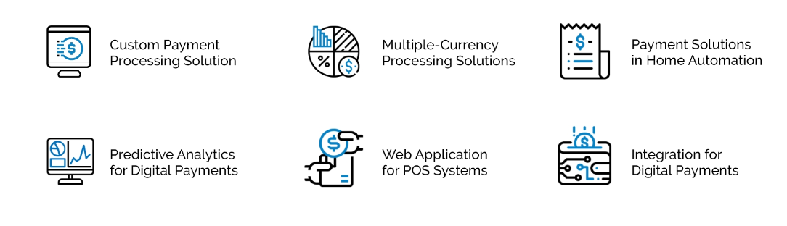
SOLUTIONS IN WEB DEVELOPMENT

Slide 4
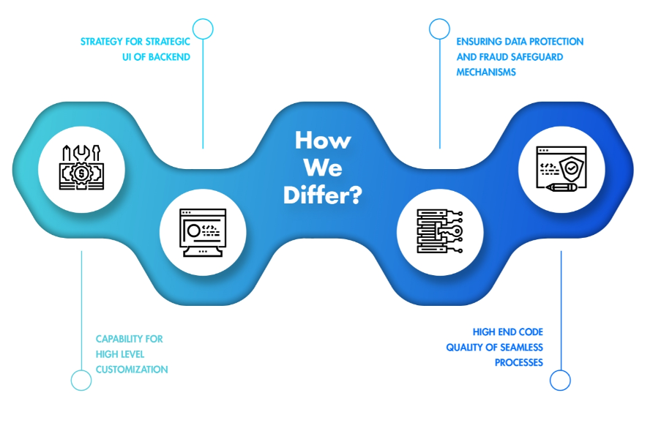

Slide 5

WEB APP DEVELOPMENT SERVICES
Our scalable and secure Web Applications are tailor made with modern
and sophisticated interface for all your niche business requirements. We are experts in developing secure web solutions.

Slide 6

OUR BLOG
As payments become streamlined with tap-to-pay,
check out our comprehensive guide on Web Payment applications and understand the driving force behind secure, swift and scalable web apps.

Slide 7


